Slide 1

Introduction myself my name is tehreem IAM from Karachi my education is inter and I currently Study CIT course

Slide 2
Self confident
I believe my self and express my thoughts clearly l put consistent effort into everything ldo and never give up early I take responsibility seriously and I enjoy thinking of new idea or solution

Slide 3

My hobbies
In my free time I enjoy reading books like novels and stories l also listening 🎧 Tillawat-e-Quran as the help me relax l also have an interest learning about technology and exploring new skills online as I believe it’s important to keep growing

Slide 4

My achievements and self evaluation
One of my academic achievement I am proud of is winning race compitation
My strength that is I enjoy new
Ideas and problem solving but my weakness is I confuse to explain solution but IAM improving by practicing

Slide 5
Skill from CIT course
In my CIT course I learned skills such as using Ms office,power point, browsing the internet effectively l also improve my typing and document formating these skill are very helpful my future career and my favourite tool is power point As it allow me to create presentation

Slide 6
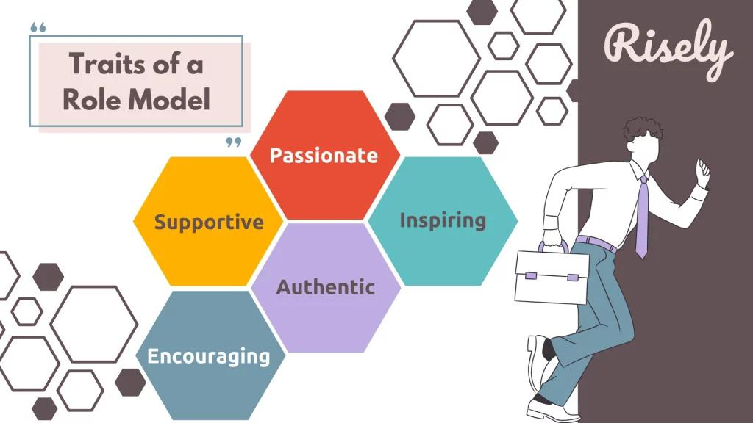
My Role model and inspiration
My Role model is my
parents they also motivate me with them patienc,care and strength I also inspired my teachers because l learn
Confidence And discipline and the value for education

Slide 7
Thank you for listening everyone that was little by me

